Slide 2
solve problems based on relation between compound and simple interest.

Slide 3
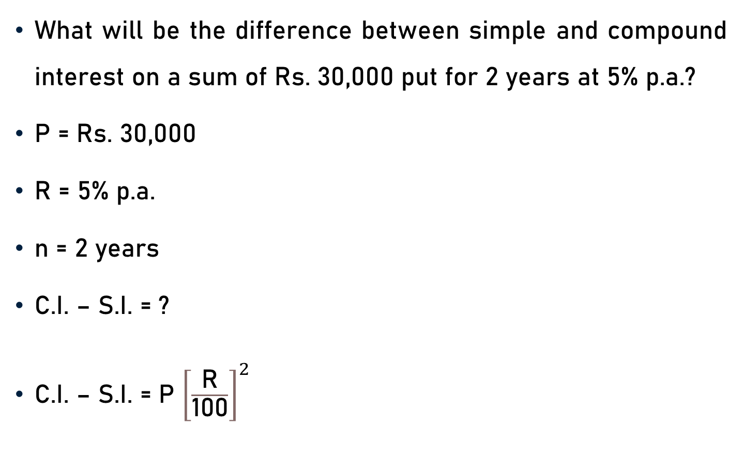
Problem 1
What will be the difference between simple and compound interest on a sum of Rs. 30,000 put for 2 years at 5% p.a.?
P = Rs. 30,000
R = 5% p.a.
n = 2 years
C.I. – S.I. = ?
C.I. – S.I. = P ${\left[\frac{\text{R}}{\text{100}}\right]}^{2}$

Slide 4
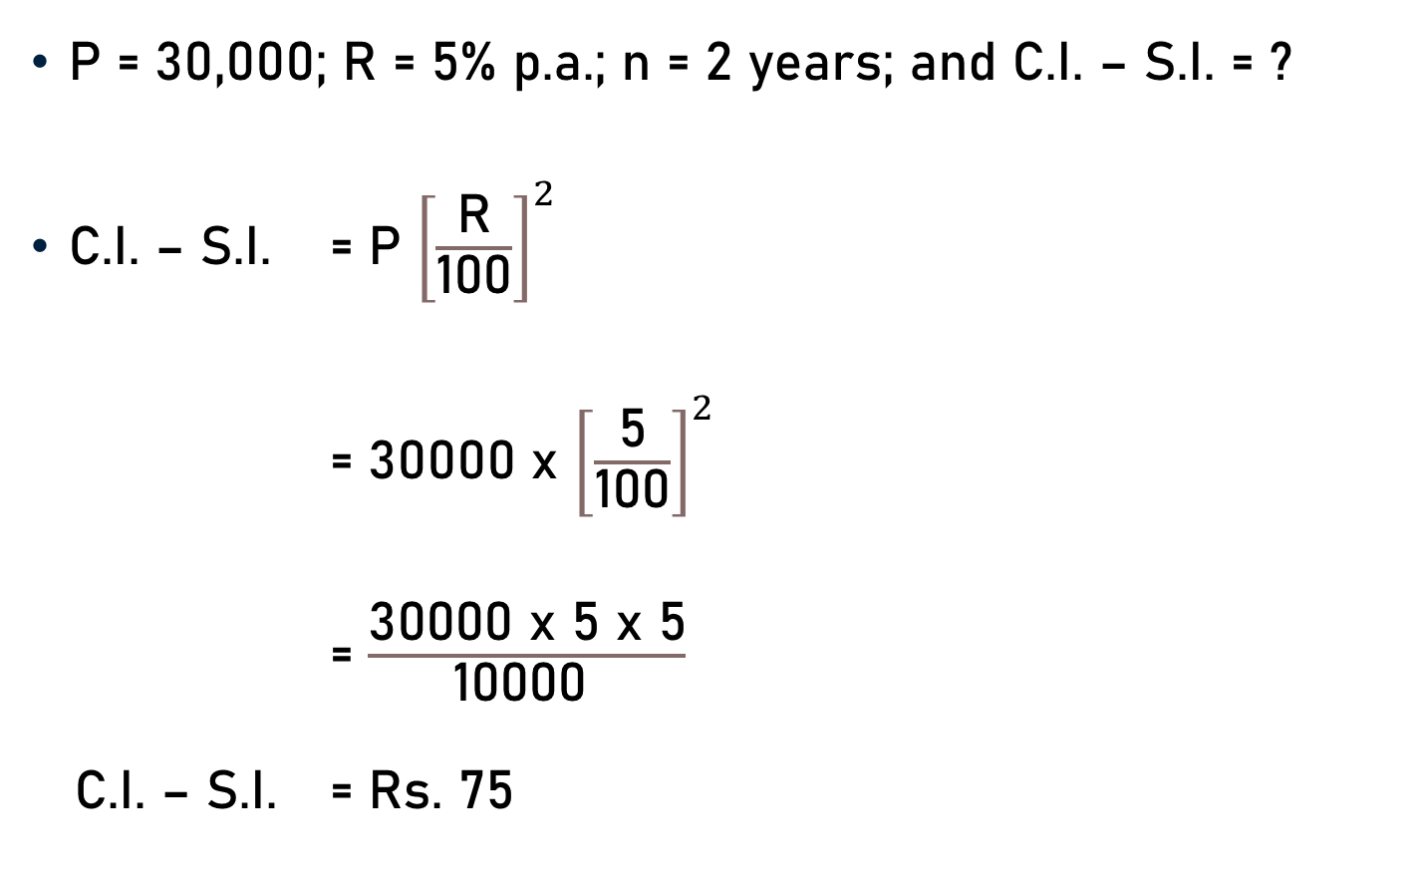
Problem 1
P = 30,000; R = 5% p.a.; n = 2 years; and C.I. – S.I. = ?
C.I. – S.I. = P ${\left[\frac{\text{R}}{\text{100}}\right]}^{2}$
= 30000 x ${\left[\frac{\text{5}}{\text{100}}\right]}^{2}$
= $\frac{\text{300}\text{00} \text{x}\text{ 5 }\text{x}\text{ 5}}{\text{10000 }}$
C.I. – S.I. = Rs. 75
3

Slide 5
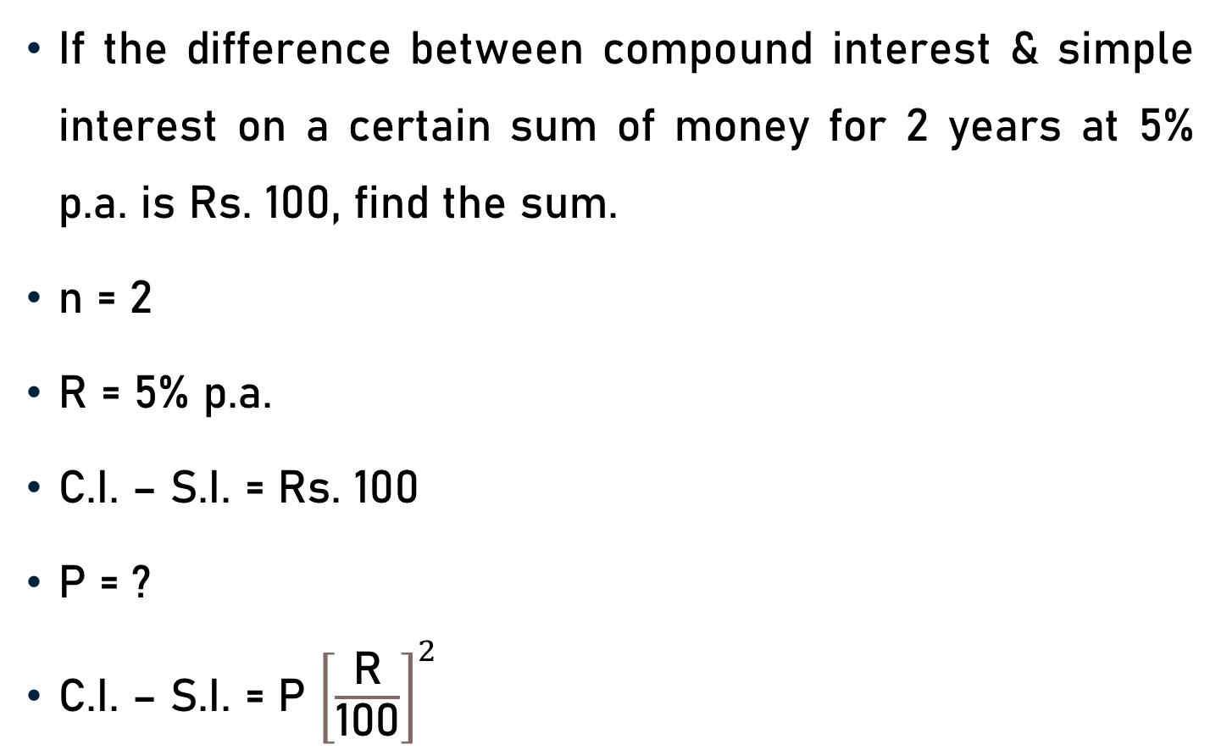
Problem 2
If the difference between compound interest & simple interest on a certain sum of money for 2 years at 5% p.a. is Rs. 100, find the sum.
n = 2
R = 5% p.a.
C.I. – S.I. = Rs. 100
P = ?
C.I. – S.I. = P ${\left[\frac{\text{R}}{\text{100}}\right]}^{2}$

Slide 6
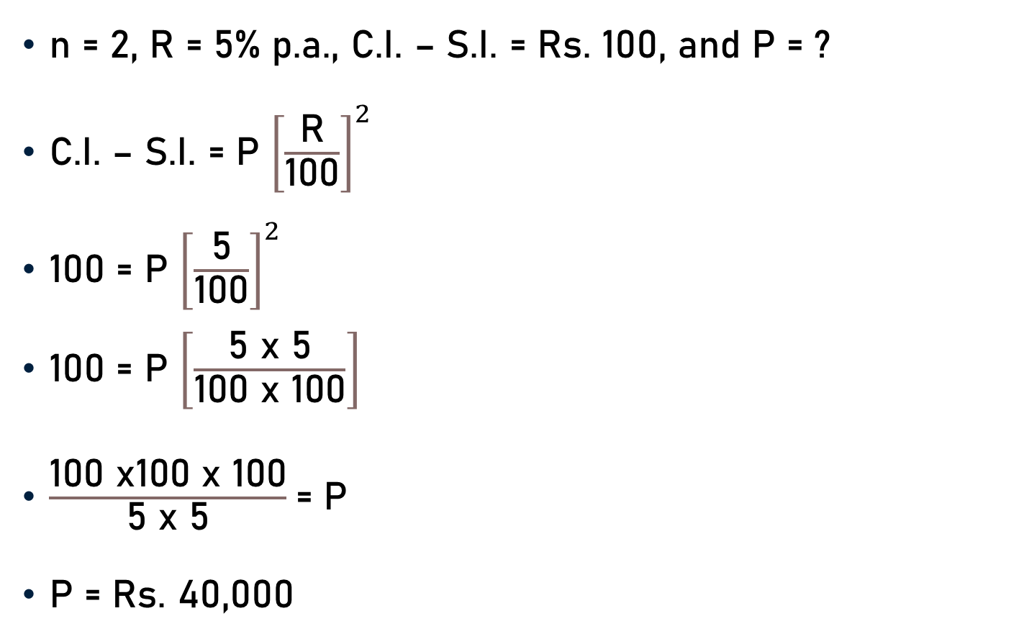
Problem 2
n = 2, R = 5% p.a., C.I. – S.I. = Rs. 100, and P = ?
C.I. – S.I. = P ${\left[\frac{\text{R}}{\text{100}}\right]}^{2}$
100 = P ${\left[\frac{\text{5}}{\text{100}}\right]}^{2}$
100 = P $\left[\frac{\text{5 }\text{x}\text{ 5}}{\text{100 }\text{x}\text{ 100}}\right]$
$\frac{\text{100} \text{x}\text{100 }\text{x}\text{ 100}}{\text{5 }\text{x}\text{ 5}}$= P
P = Rs. 40,000
20
4

Slide 7
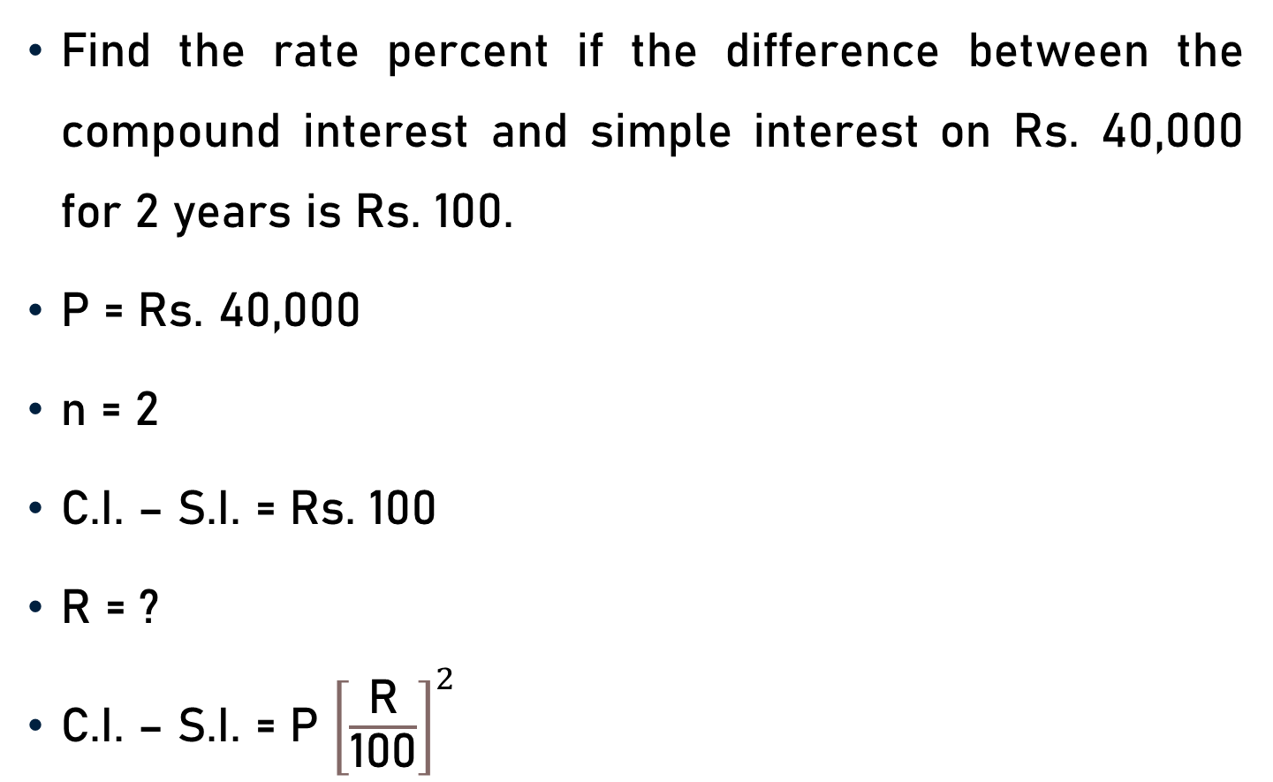
Problem 3
Find the rate percent if the difference between the compound interest and simple interest on Rs. 40,000 for 2 years is Rs. 100.
P = Rs. 40,000
n = 2
C.I. – S.I. = Rs. 100
R = ?
C.I. – S.I. = P ${\left[\frac{\text{R}}{\text{100}}\right]}^{2}$

Slide 8
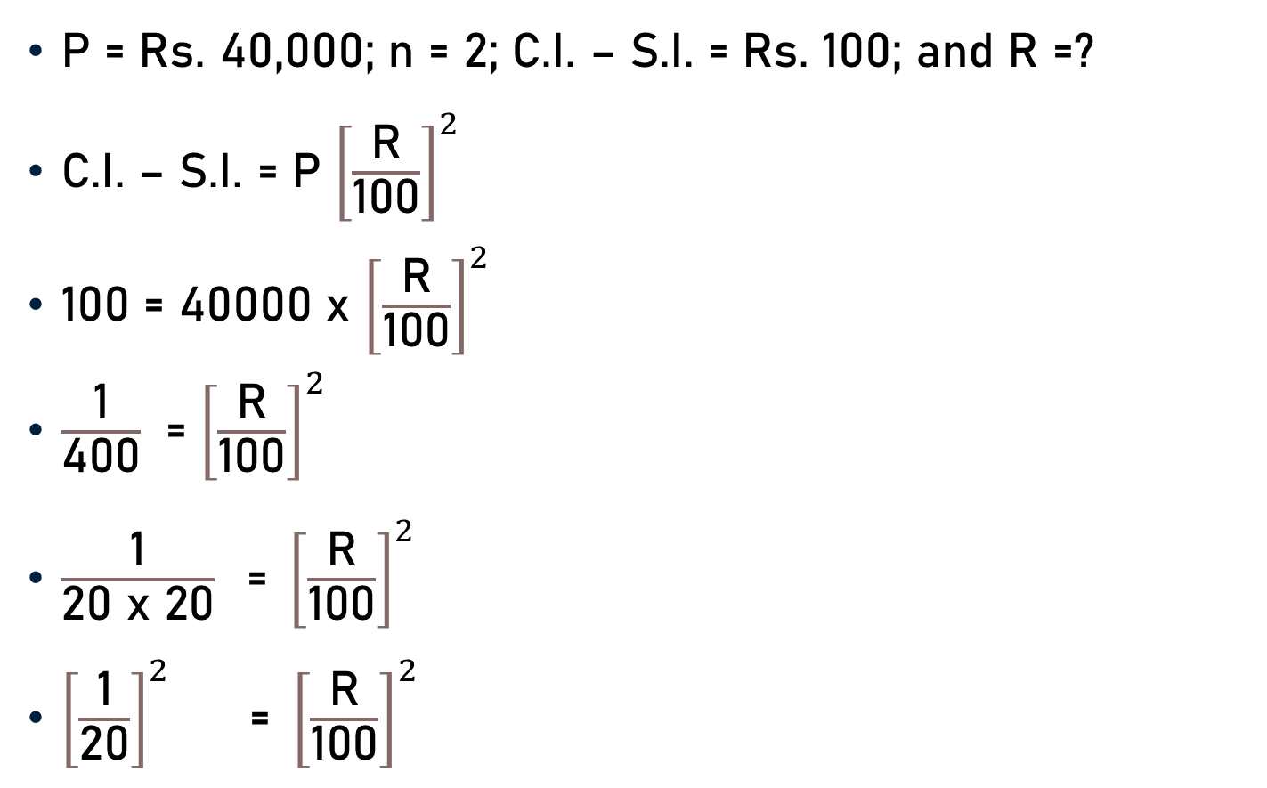
Problem 3
P = Rs. 40,000; n = 2; C.I. – S.I. = Rs. 100; and R =?
C.I. – S.I. = P ${\left[\frac{\text{R}}{\text{100}}\right]}^{2}$
100 = 40000 x ${\left[\frac{\text{R}}{\text{100}}\right]}^{2}$
$\frac{\text{1}}{\text{4}\text{00}}$ = ${\left[\frac{\text{R}}{\text{100}}\right]}^{2}$
$\frac{\text{1}}{\text{2}\text{0} \text{x}\text{ 20}} \text{ = }{\left[\frac{\text{R}}{\text{100}}\right]}^{2}$
${\left[\frac{\text{1}}{\text{2}\text{0}}\right]}^{2}$ =${ \left[\frac{\text{R}}{\text{100}}\right]}^{2}$

Slide 9

Problem 3
${\left[\frac{\text{1}}{\text{2}\text{0}}\right]}^{2}$ =${ \left[\frac{\text{R}}{\text{100}}\right]}^{2}$
${\left[\frac{\text{1}}{\text{2}\text{0}}\right]}^{2}$ = ${\left[\frac{\text{R}}{\text{100}}\right]}^{2}$
$\frac{\text{1}}{\text{20}}$ = $\frac{\text{R}}{\text{100}}$
R = 5% p.a.
5

Slide 10
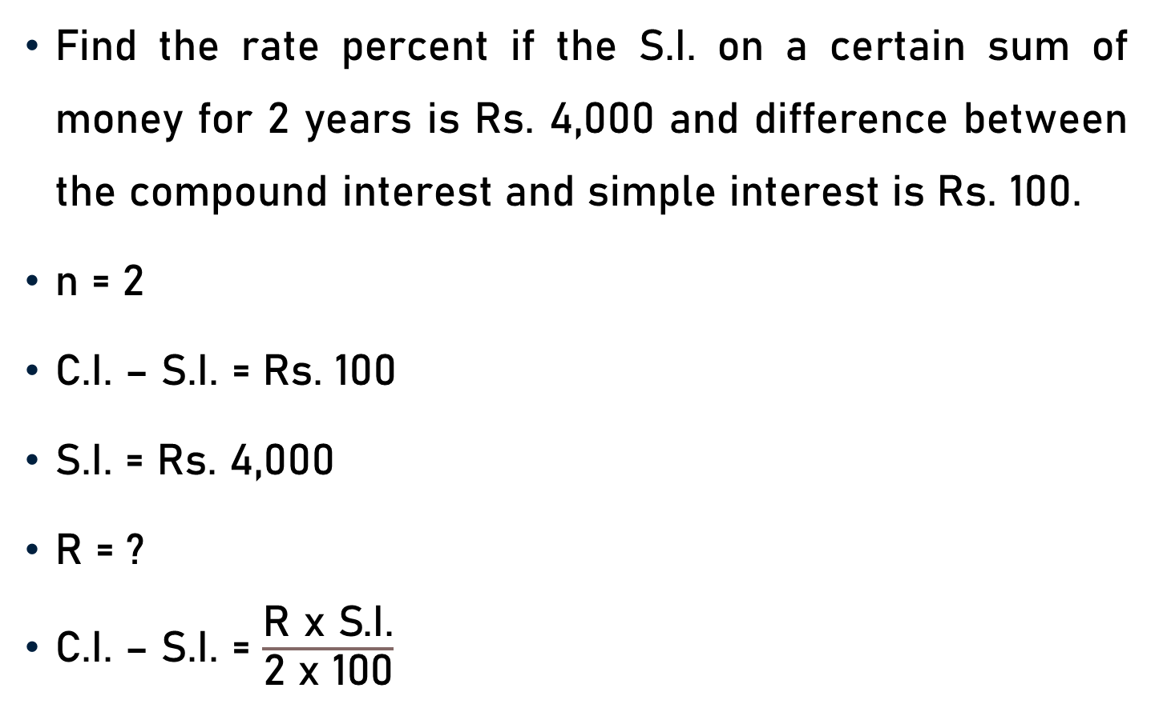
Problem 4
Find the rate percent if the S.I. on a certain sum of money for 2 years is Rs. 4,000 and difference between the compound interest and simple interest is Rs. 100.
n = 2
C.I. – S.I. = Rs. 100
S.I. = Rs. 4,000
R = ?
C.I. – S.I. = $\frac{\text{R} \text{x} \text{S}\text{.}\text{I}\text{.}}{\text{2 }\text{x}\text{ 100}}$

Slide 11
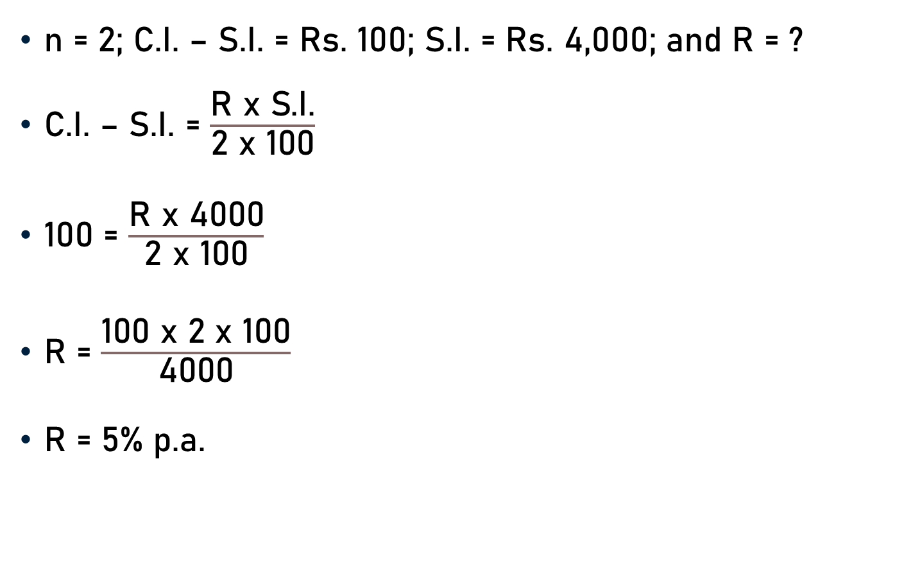
Problem 4
n = 2; C.I. – S.I. = Rs. 100; S.I. = Rs. 4,000; and R = ?
C.I. – S.I. = $\frac{\text{R} \text{x} \text{S}\text{.}\text{I}\text{.}}{\text{2 }\text{x}\text{ 100}}$
100 = $\frac{\text{R} \text{x}\text{ 4000}}{\text{2 }\text{x}\text{ 100}}$
$\text{R}$ = $\frac{\text{100} \text{x}\text{ 2 }\text{x} \text{1}\text{00}}{\text{4000}}$
$\text{R}$ = 5% p.a.
5
40
20

Slide 12
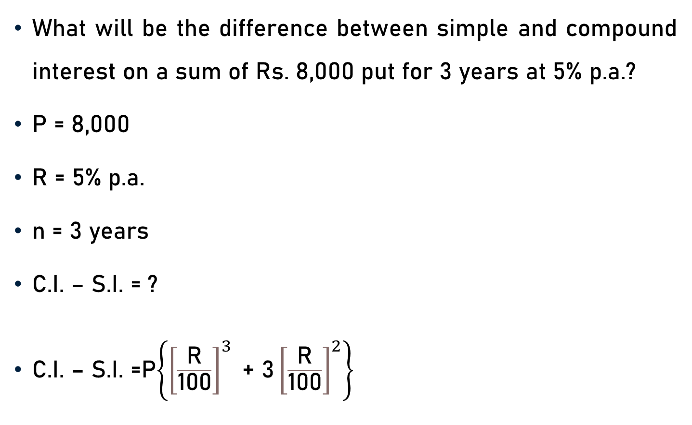
Problem 5
What will be the difference between simple and compound interest on a sum of Rs. 8,000 put for 3 years at 5% p.a.?
P = 8,000
R = 5% p.a.
n = 3 years
C.I. – S.I. = ?
C.I. – S.I. =P$\left\{{\left[\frac{\text{R}}{\text{100}}\right]}^{3}\text{ + 3}{\left[\frac{\text{R}}{\text{100}}\right]}^{2}\right\}$

Slide 13
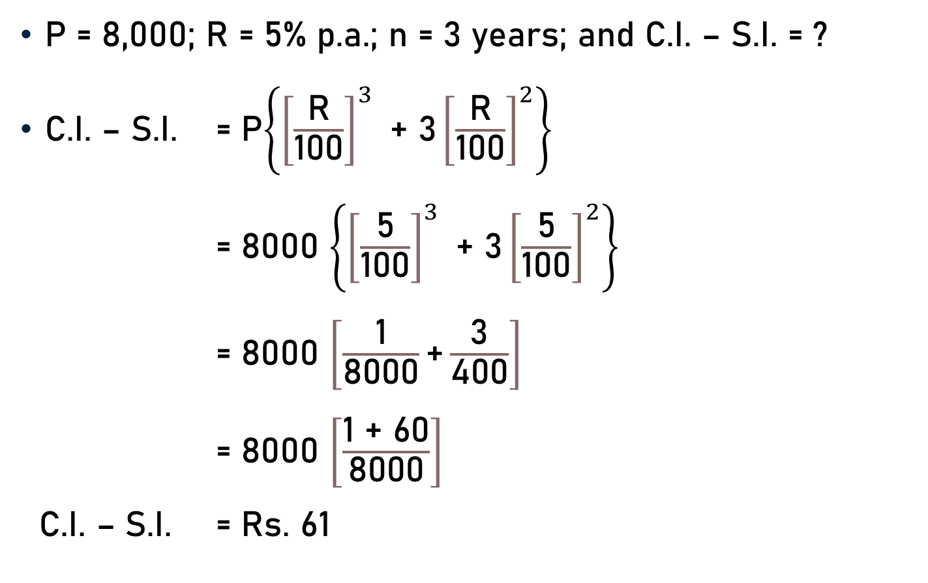
Problem 5
P = 8,000; R = 5% p.a.; n = 3 years; and C.I. – S.I. = ?
C.I. – S.I. = P$\left\{{\left[\frac{\text{R}}{\text{100}}\right]}^{3}\text{ + 3}{\left[\frac{\text{R}}{\text{100}}\right]}^{2}\right\}$
= 8000 $\left\{{\left[\frac{\text{5}}{\text{100}}\right]}^{3}\text{ + 3}{\left[\frac{\text{5}}{\text{100}}\right]}^{2}\right\}$
= 8000 $\left[\frac{\text{1}}{\text{8}\text{00}\text{0}}\text{+}\frac{\text{3}}{\text{4}\text{00}}\right]$
= 8000 $\left[\frac{\text{1 }\text{+} \text{6}\text{0}}{\text{8}\text{000}}\right]$
C.I. – S.I. = Rs. 61
20
20

Slide 14
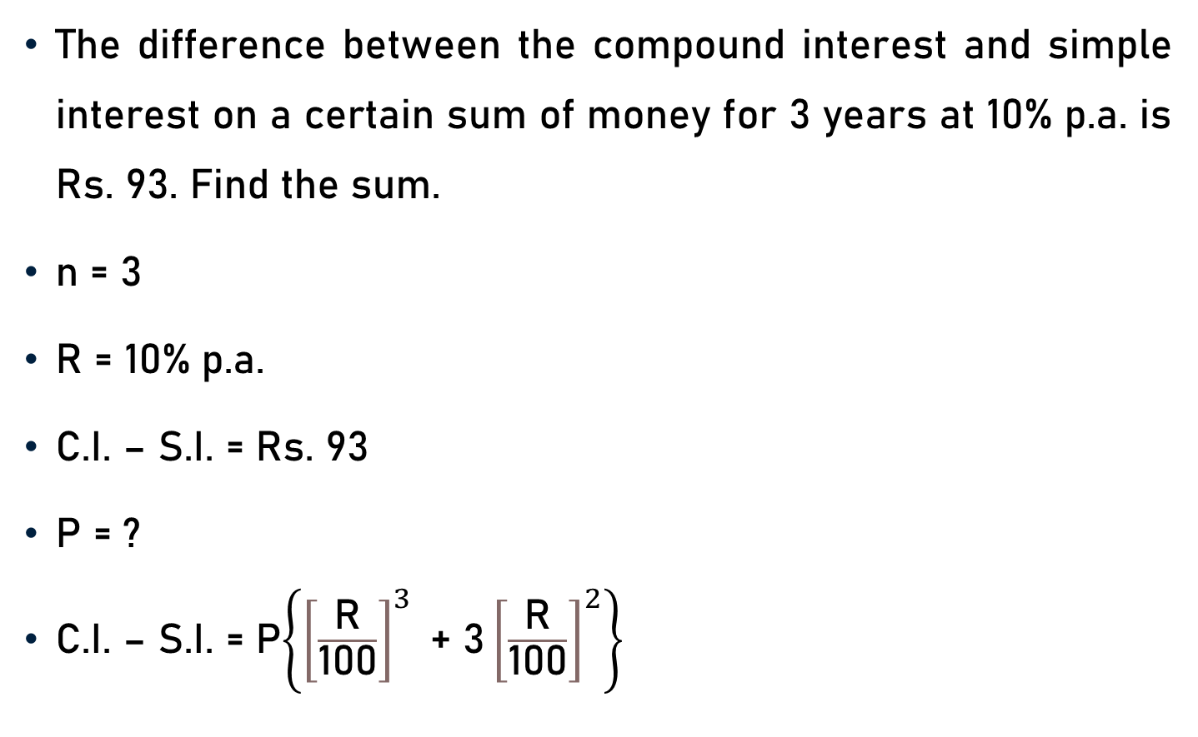
Problem 6
The difference between the compound interest and simple interest on a certain sum of money for 3 years at 10% p.a. is Rs. 93. Find the sum.
n = 3
R = 10% p.a.
C.I. – S.I. = Rs. 93
P = ?
C.I. – S.I. = P$\left\{{\left[\frac{\text{R}}{\text{100}}\right]}^{3}\text{ + 3}{\left[\frac{\text{R}}{\text{100}}\right]}^{2}\right\}$

Slide 15
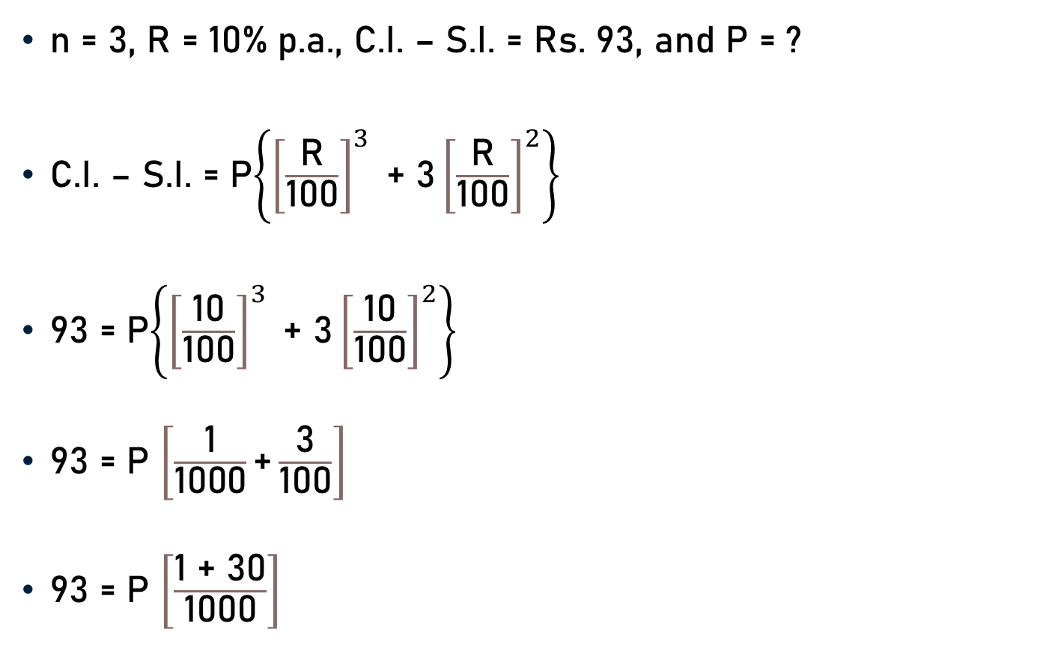
Problem 6
n = 3, R = 10% p.a., C.I. – S.I. = Rs. 93, and P = ?
C.I. – S.I. = P$\left\{{\left[\frac{\text{R}}{\text{100}}\right]}^{3}\text{ + 3}{\left[\frac{\text{R}}{\text{100}}\right]}^{2}\right\}$
93 = P$\left\{{\left[\frac{\text{10}}{\text{100}}\right]}^{3}\text{ + 3}{\left[\frac{\text{10}}{\text{100}}\right]}^{2}\right\}$
93 = P $\left[\frac{\text{1}}{\text{1000}}\text{+}\frac{\text{3}}{\text{100}}\right]$
93 = P $\left[\frac{\text{1 }\text{+} \text{3}\text{0}}{\text{1000}}\right]$

Slide 16

Problem 6
93 = P $\left[\frac{\text{1 }\text{+} \text{3}\text{0}}{\text{1000}}\right]$
93 = P $\left[\frac{\text{3}\text{1}}{\text{1000}}\right]$
P = $\frac{\text{93} \text{x}\text{ 1000}}{\text{31} }$
P =$\text{Rs}\text{. 3000}$
3

Slide 17
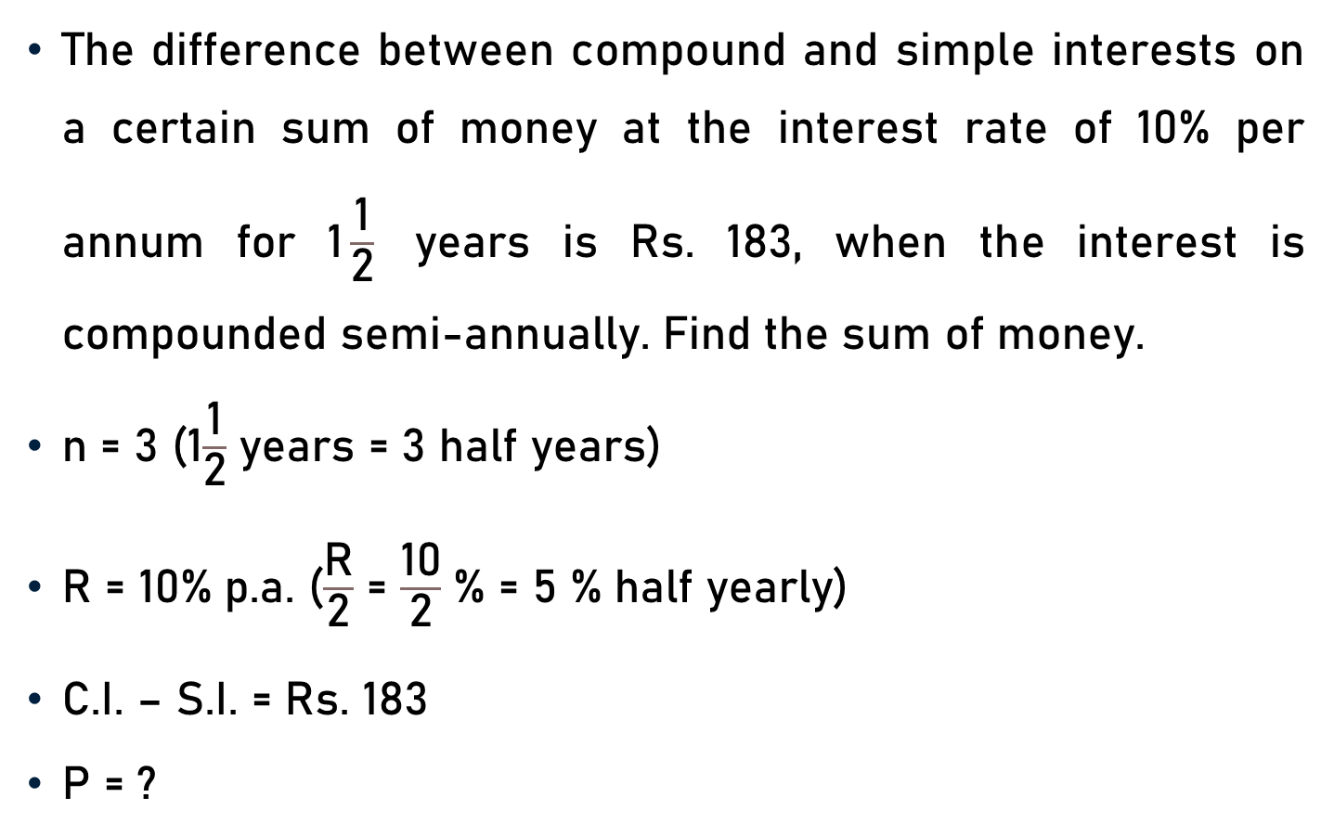
Problem 7
The difference between compound and simple interests on a certain sum of money at the interest rate of 10% per annum for 1$\frac{\text{1}}{\text{2}}$ years is Rs. 183, when the interest is compounded semi-annually. Find the sum of money.
n = 3 (1$\frac{\text{1}}{\text{2}}$ years = 3 half years)
R = 10% p.a. ($\frac{\text{R}}{\text{2}}$ = $\frac{\text{10}}{\text{2}}$ % = 5 % half yearly)
C.I. – S.I. = Rs. 183
P = ?

Slide 18
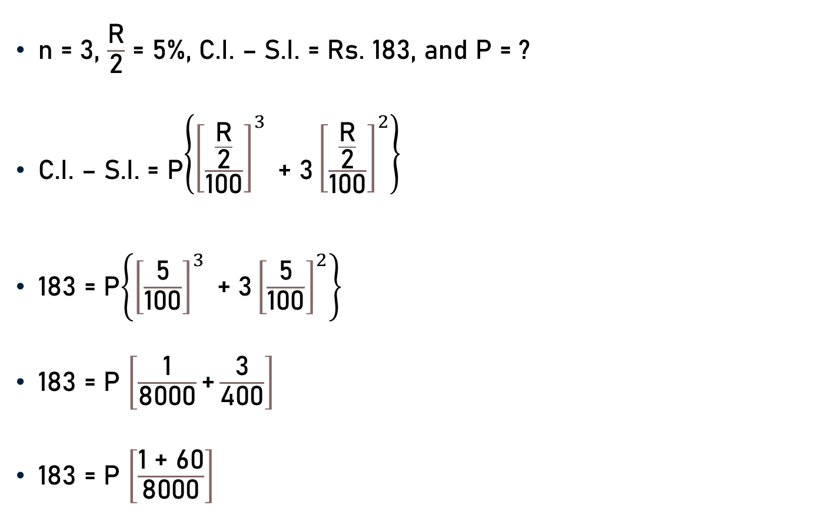
Problem 7
n = 3, $\frac{\text{R}}{\text{2}}$ = 5%, C.I. – S.I. = Rs. 183, and P = ?
C.I. – S.I. = P$\left\{{\left[\frac{\frac{\text{R}}{\text{2}}}{\text{100}}\right]}^{3}\text{ + 3}{\left[\frac{\frac{\text{R}}{\text{2}}}{\text{100}}\right]}^{2}\right\}$
183 = P$\left\{{\left[\frac{\text{5}}{\text{100}}\right]}^{3}\text{ + 3}{\left[\frac{\text{5}}{\text{100}}\right]}^{2}\right\}$
183 = P $\left[\frac{\text{1}}{\text{8}\text{000}}\text{+}\frac{\text{3}}{\text{4}\text{00}}\right]$
183 = P $\left[\frac{\text{1 }\text{+} \text{6}\text{0}}{\text{8}\text{000}}\right]$
20
20

Slide 19

Problem 7
183 = P $\left[\frac{\text{1 }\text{+} \text{6}\text{0}}{\text{8}\text{000}}\right]$
183 = P $\left[\frac{\text{6}\text{1}}{\text{8}\text{000}}\right]$
P = $\frac{\text{18}\text{3} \text{x}\text{ 8000}}{\text{6}\text{1} }$
P =$\text{Rs}\text{. 2400}\text{0}$
3

Slide 20

Conclusion
For 2 years at R% per annum
  In terms of P and R
    C.I. – S.I. = P ${\left[\frac{\text{R}}{\text{100}}\right]}^{2}$
  In terms of S.I. and R
    C.I. – S.I. = $\frac{\text{R} \text{x} \text{S}\text{.}\text{I}\text{.}}{\text{2 }\text{x}\text{ 100}}$

Slide 21
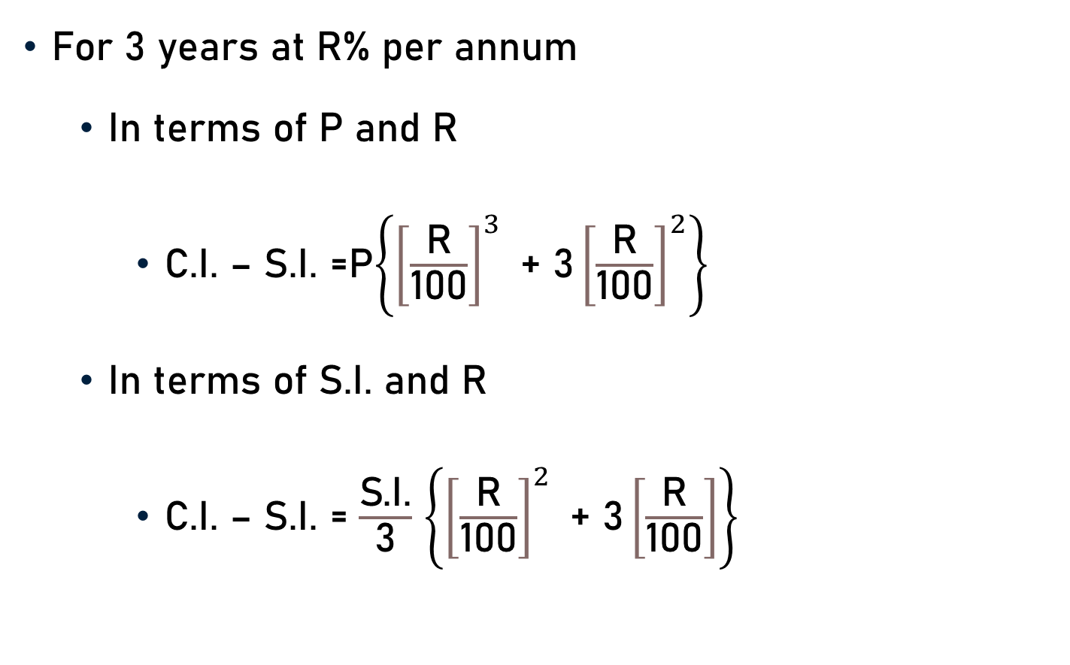
Conclusion
For 3 years at R% per annum
  In terms of P and R
    C.I. – S.I. =P$\left\{{\left[\frac{\text{R}}{\text{100}}\right]}^{3}\text{ + 3}{\left[\frac{\text{R}}{\text{100}}\right]}^{2}\right\}$
  In terms of S.I. and R
    C.I. – S.I. = $\frac{\text{S}\text{.}\text{I}\text{.}}{\text{3}}$ $\left\{{\left[\frac{\text{R}}{\text{100}}\right]}^{2}\text{ + 3}\left[\frac{\text{R}}{\text{100}}\right]\right\}$

Slide 22
Summary
Computation of
  Difference between C.I. and S.I.
  Principal
  Rate

